Slide 1




Git & Github
Dr. Faris Llwaah
University of Mosul
College of Computer Sciences and Mathematics
Department of Computing Sciences

Slide 2
Outline
1- Introduction
History and fundamentals concepts
2- Introduction to Git
What is Git?

Slide 3
What is version control System (VCS)?
The purpose of version control system is to allow software teams track changes to the code, while enhancing communication and collaboration between team members. Version control system facilitates a continuous, simple way to develop software.
The VCS helps the developer to analyse project:
VCS provides you with proper description
what exactly was changed
When it was changed
And hence, you can analyse how your project
evolved between versions.

Slide 5
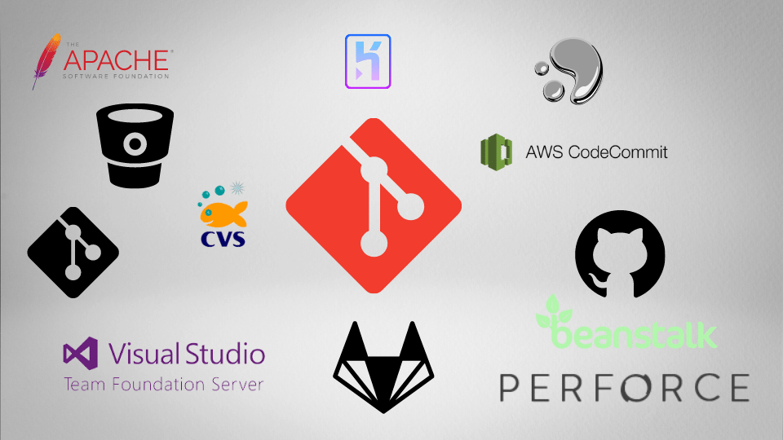
Many different VCS exists now our days. The most common examples are listed below.

Slide 6
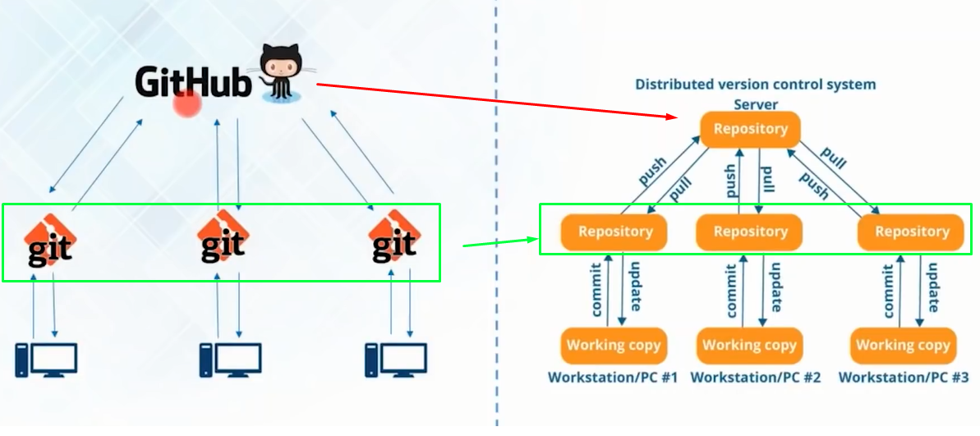

Slide 7
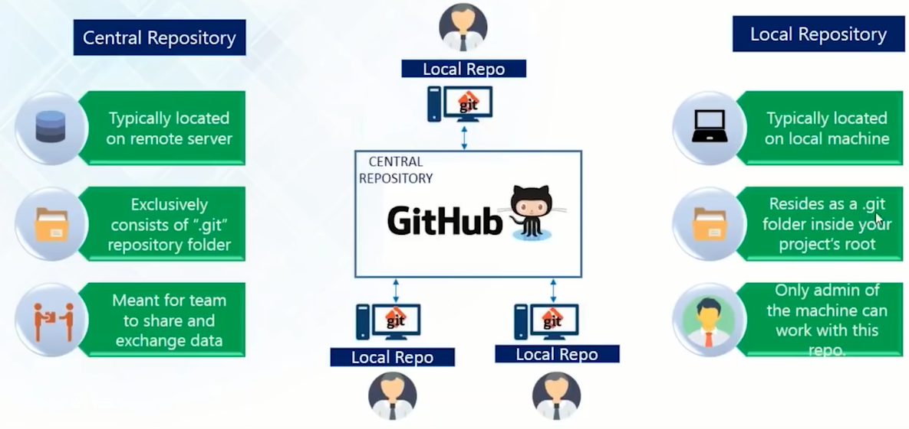

Slide 8
What is Git?
Git is an extremely fast, efficient, distributed version control system used for collaborative development of software.
Git was designed and
developed by Linus Torvalds,
April 2005.

Slide 9
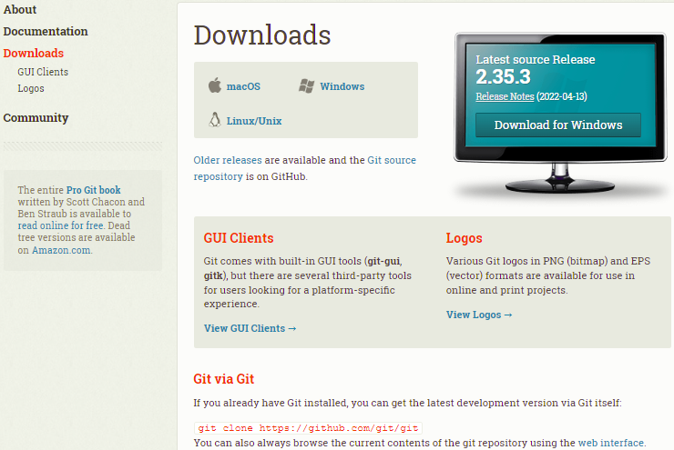
Installing Git (Local Repository)
installing Git is simple
download and follow the steps of installation.
Find detailed of installation in the following Link:
https://git-scm.com/downloads

Slide 10
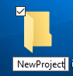
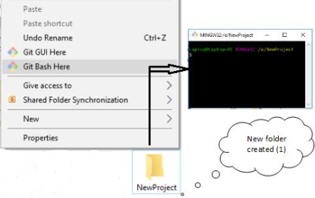
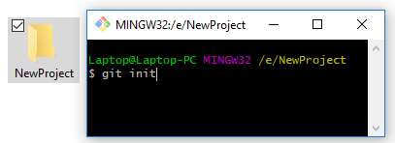
Working with Repositories (Local repo)
A repository is a storage where all your project and all the changes made to it are kept. You can think of it as a “change database”.
For each project you want to manage with Git, you have to set up a repository for it. Setting up a repository is very easy. Just navigate to the folder you want to track and tell Git to initiate a repository there. So for each project you want to start, you should:
1- Create the directory containing your project
2- Navigate into the directory
3- Initialize a Git repository

Slide 11
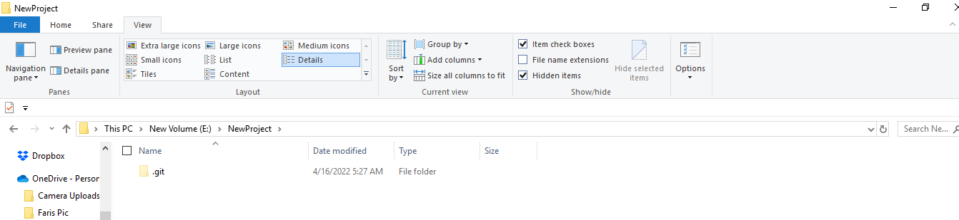
Initialize a Git repository (Local repo)
$ git init
Git will create a directory called “.git” that will contain all your change sets and
snapshots. If you want to check it out, you will have to show hidden files from your file explorer’s settings. The repository looks like the directory shown in following Figure.

Slide 12
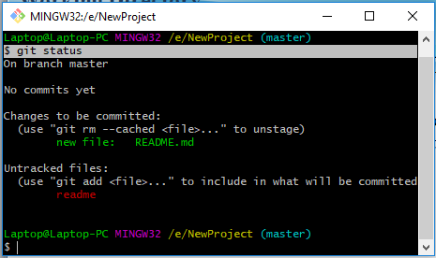
Working Directory
The empty area outside the “.git” directory is called the Working Directory. The files you will be working on will be stored there.
Git will detect any new file you will place in the Working Directory. And you check the status of the directory by using the Git command “status.”

Slide 13
The most popular commands of Git
$ git init create empty repository
$ git clone <repo> clone existing repository
$ git add . Stage all changes
$ git add <file-path> Specifies the files you
want to add to the Staging
Area
$ git commit –m <msg> commit changes with
message
$ git status list staged/ unchanged/
untracked changes
$ git log display commit history
$ git diff show un-staged changes
$ git restore <file> to discard changes in
working directory)

Slide 14
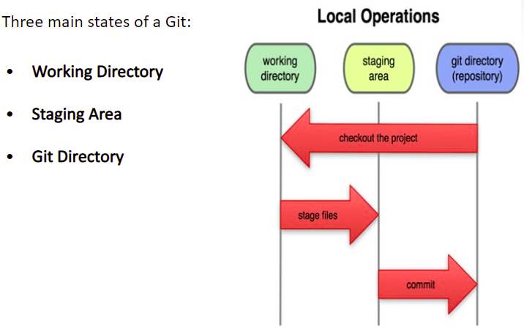
Git uses a three- tree architecture

Slide 15
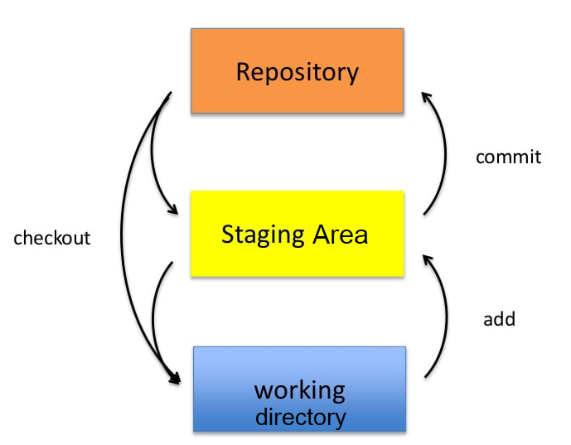
Git uses a three- tree architecture

Slide 16
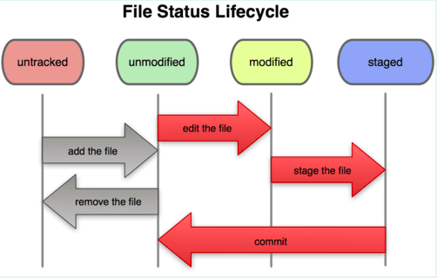
Recording changes to the repository
Each file in your working directory can be in one of the following two status: Tracked or Untracked
File Status in Life Cycle
Untracked
Unmodified
Modified
Staged

Slide 17
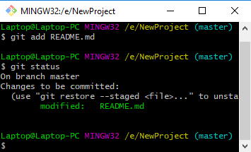
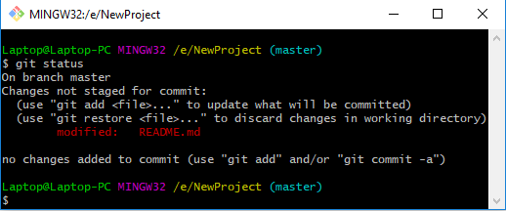
Checking the status of your files
Command: $ git status
1- Untracked files- Files in your working directory that are not present in your last snapshot and staging area.
2- Tracked files- Files that are present in the last snapshot.
The following command is used to make the file status as trackable
Command: $ git add <file name>

Slide 18
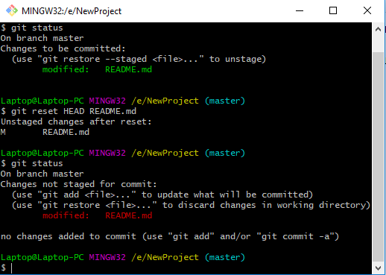
Checking the status of your files
1- Staging Modified files- A File which is already tracked and has been
modified in the working directory, but not yet stage.
2- Un-staging Modified files- A File that is out of staging area.
The following command is used to make the file unstaged.
Command: $ git reset HEAD <file name>

Slide 19
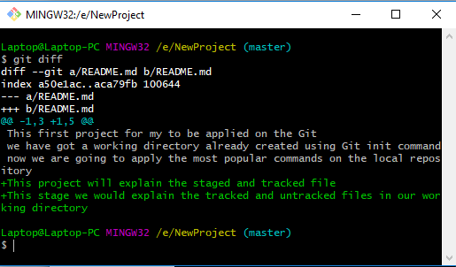
Viewing your staged and Unstaged changes
To view the difference between staged and Unstaged files.
Command: $ git diff
To view the difference between staged and the last committed file.
Command: $ git diff -cached

Slide 20
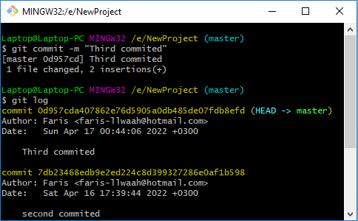
Committing your changes
To commit along with comments
Command: $ git commit –m <msg>
Undo the commit
Command: $ git reset HEAD~

Slide 21
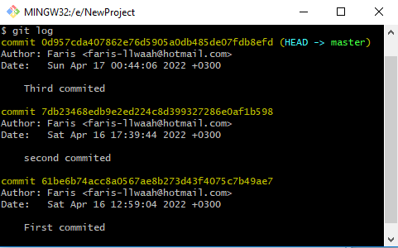
Committing your changes
To display commit history
Command: $ git log
list staged/ unchanged/ untracked changes
Command: $ git status

Slide 22
What is Github?
So far, we have been working with Git on a local system. To put your project up on GitHub, you will need to have a GitHub repository for it to live in
Github is a web-based hosting service for software development project that use the Git revision control system. Github was founded by Chris Wanstrath and tom Preston-Werner and PJ Hyett.

Slide 23
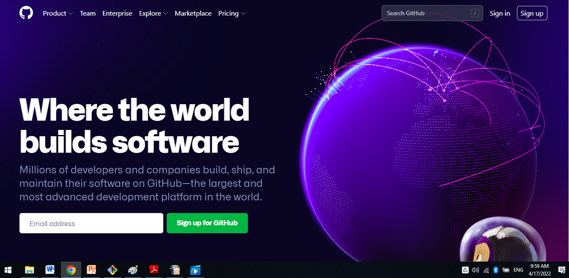
Github Registration:
We would need to create an account with GitHub is obviously free. We can do so via this link here:
https://github.com/

Slide 24
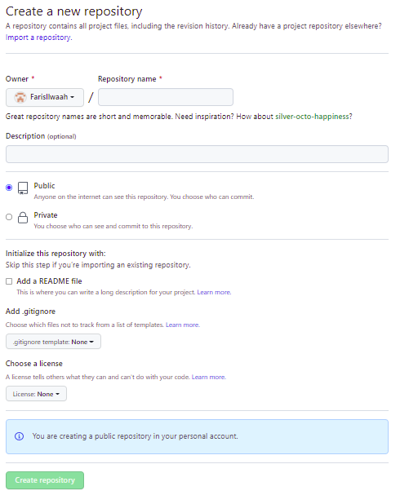
Creating a new repository
To create a new repository on GitHub, you have to click on the + sign on the top right corner or click on the green NEW button in the top-left where repositories are mentioned and then click on the New Repository button:

Slide 25
Creating a new repository
We can specify the information for our new repository like:
The name of the project: Here, make sure to use something descriptive.
Some general description about the project and what it is about.
Choose whether you want the repository to be Public or Private.

Slide 26
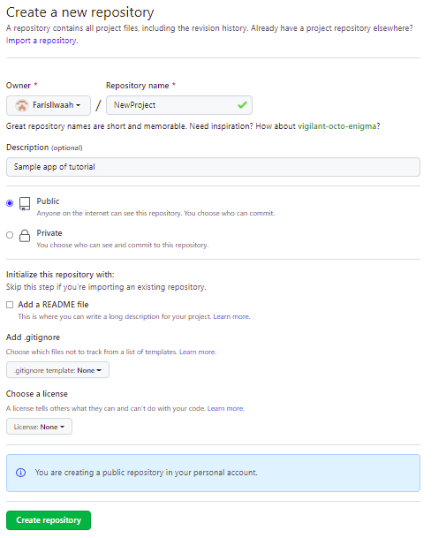
Creating a new repository

Slide 27
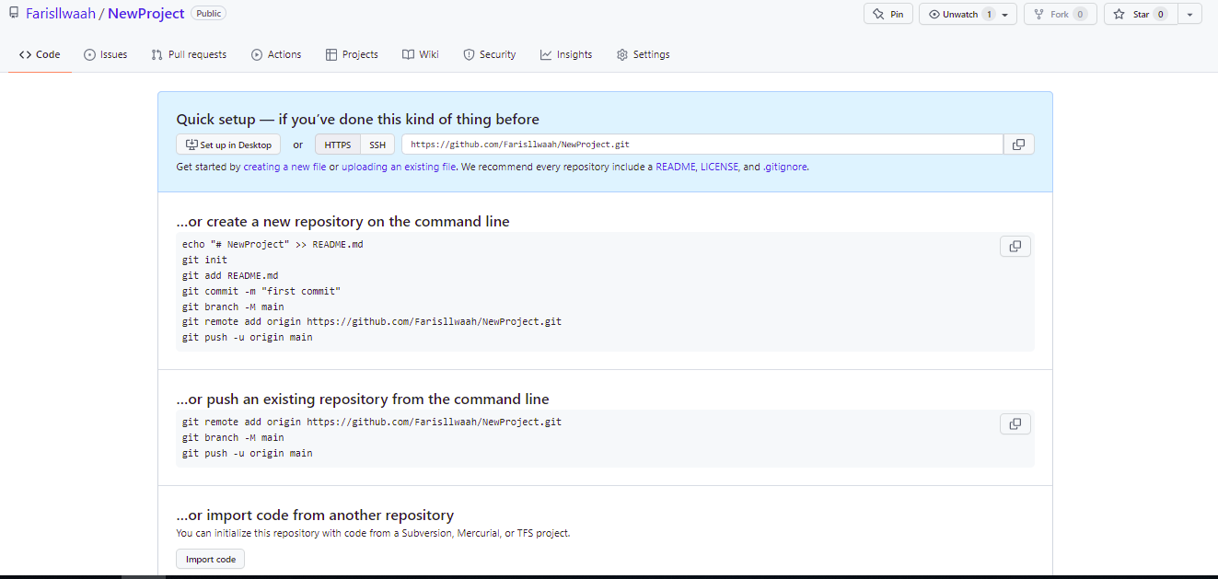
Creating a new repository

Slide 28
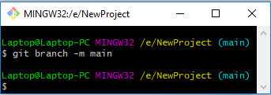
Connecting local repo with remote repo
The following commands are already done in the Local repo
$ git init
$ git add README.md
$ git commit -m "first commit“
Then must ensure we are in the main branch in the locally by applying the following command:
$ git branch -M main
Using the Link of remote repo to connect both (remote repo + local repo) apply the following command:
$ git remote add origin https://github.com/Farisllwaah/NewProject.git

Slide 29
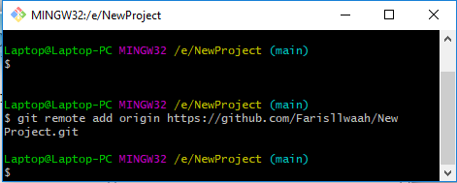
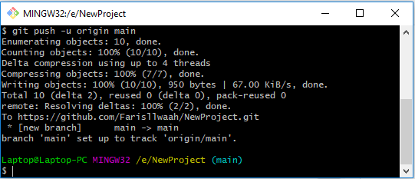
Connecting local repo with remote repo
$ git remote add origin https://github.com/Farisllwaah/NewProject.git
$ git push -u origin main

Slide 30
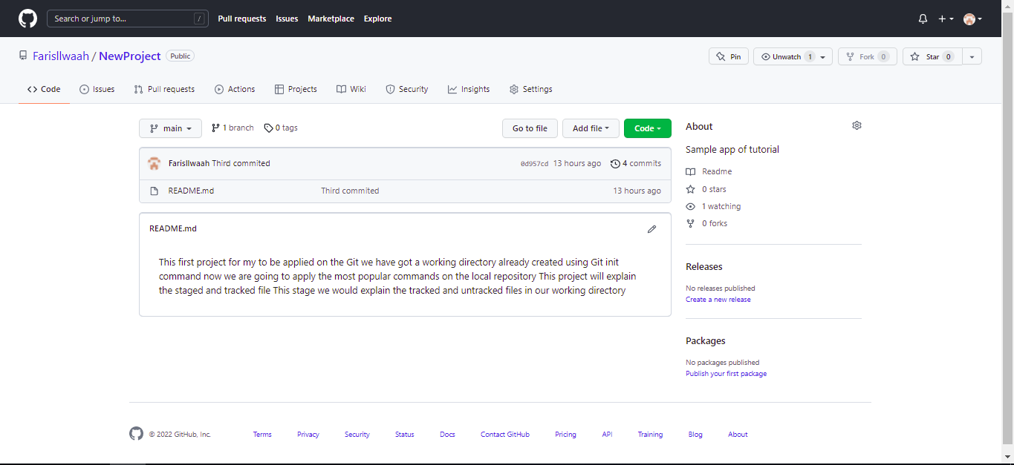
Connecting local repo with remote repo

Slide 31
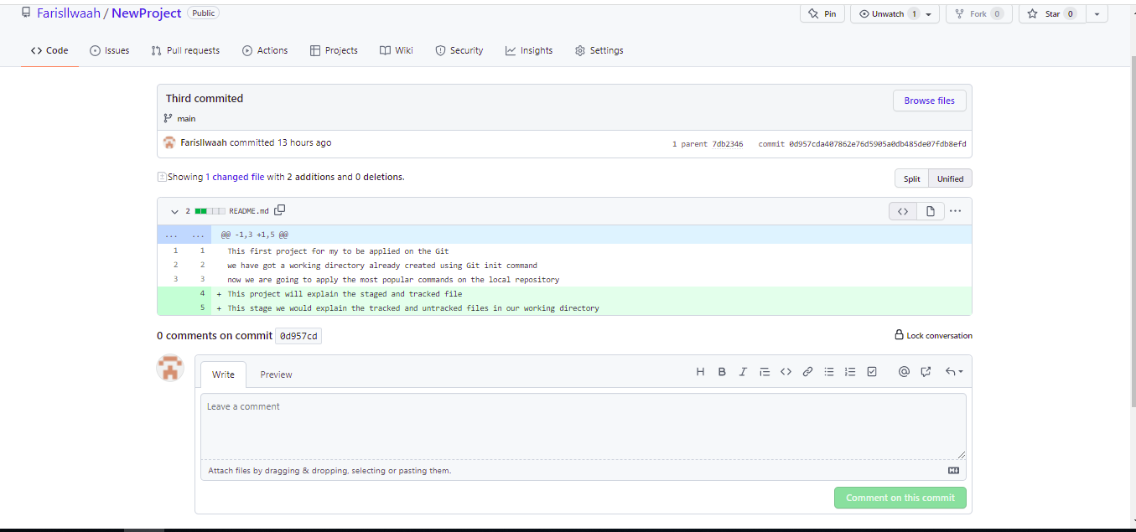
Connecting local repo with remote repo

Slide 32
The README.md file
The README.md file is an essential part of each project. The .md extension stands for Markdown.
For more information about Markdown see the following link:
https://devdojo.com/mithicher/build-a-markdown-editor-component-with-alpinejs-laravel-blade-component
You can think of the README.md file as the introduction to your repository. It's beneficial because while looking at someone's repo, you can just scroll down to their README file and have a look at what their project is all about.
And it is crucial that your project is properly introduced. Because if the project itself isn't introduced properly, no one will spend their time helping to improve it and try to develop it further.

Slide 33
ماهو نظام التحكم في الاصدار(VCS) ؟
هو نظام يسمح بتسجيل التغيرات على الملفات بمرور الوقت وبالتالي يمكن المبرمج أو الباحث من عرض اصدارات معينة من هذه الملفات لاحقاً.
يقدم للمطورين مراجعة محفوظات المشروع وذلك:
1- لمعرفة التغيرات التي تم أجراؤها
2- من قام بالتغيرات
3- متى تم أجراء التغيرات
4- لماذا كانت هنالك حاجة للتغيرات

